Slide 1
Building & Mining Knowledge Graphs
KEN4256
Lecture 9: Network Science and Graph Analytics

Slide 2
© 2024 by Michel Dumontier and the Institute of Data Science at Maastricht University is licensed under Attribution 4.0 International
To view a copy of this license, visit http://creativecommons.org/licenses/by/4.0/
This license requires that reusers give credit to the creator. It allows reusers to distribute, remix, adapt, and build upon the material in any medium or format, even for commercial purposes.
id: KEN4256_L9
version: 1.2024.0
created: March 15, 2021
last modified: March 26, 2024
published on: March 26, 2024

Slide 3
Network Science & Graph Analytics
Network Science aims to understand and analyze the structure, behavior, and dynamics of complex networks and systems.
A network refers to some real world phenomena of connected entities.
A graph is the computational representation of that network.
Graph analytics involves the application of algorithms over graphs to gain insights into network structure and dynamics.

Slide 4
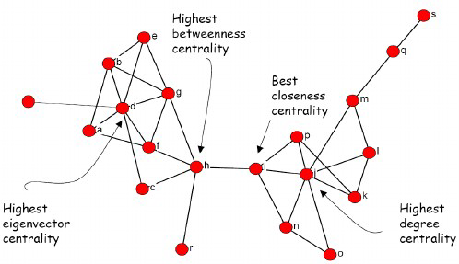
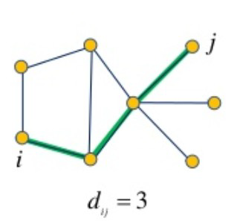
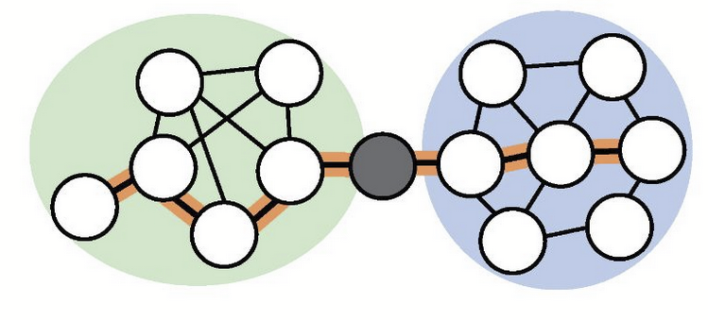
Network Science & Graph Analytics
A key instrument of network science is the analysis of network topology: Analyzing the structure of networks, including the identification of important nodes (e.g., hubs or influencers in social networks), links, or substructures that play critical roles in the functioning of the network.
Node centrality
Path analysis
Topological clustering

Slide 5
Centrality measures
Importance of the node in a network based on the topological structure of the network

Slide 6
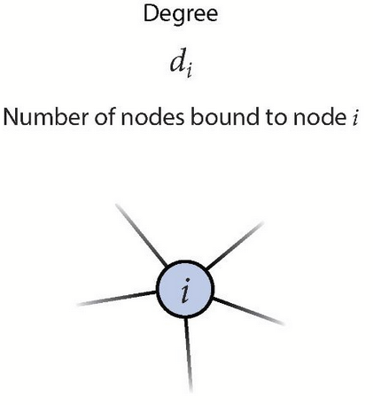
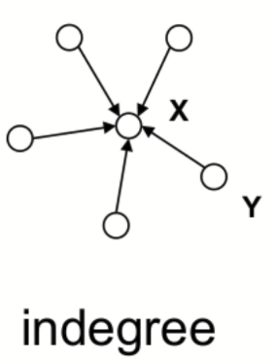
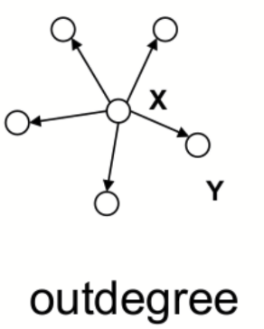
Node centralities
Degree centrality: measure the number of nodes adjacent to a node (degree)
# of incoming edges
# of outgoing edges

Slide 7
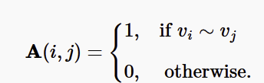
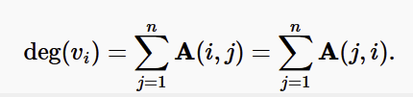
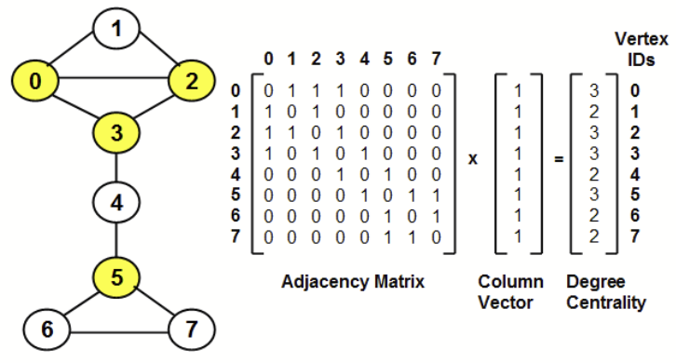
The adjacency matrix (and linear algebra) used as a basis for many network computations

Slide 8
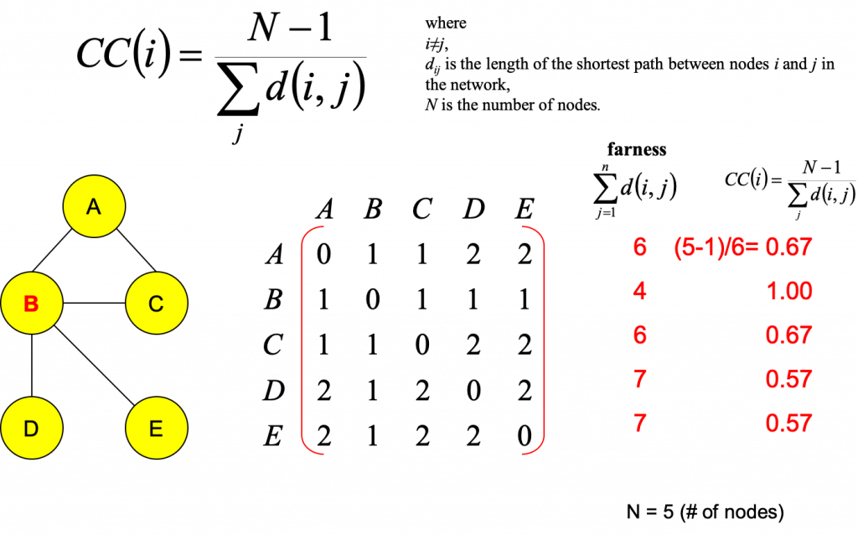
Closeness centrality

Slide 9
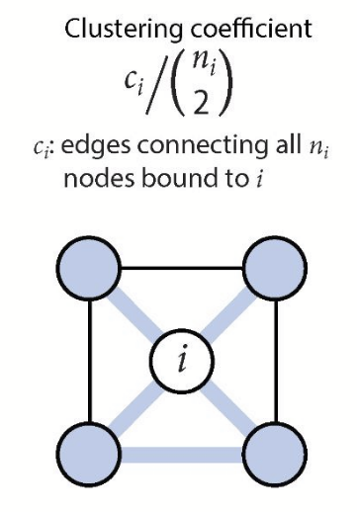
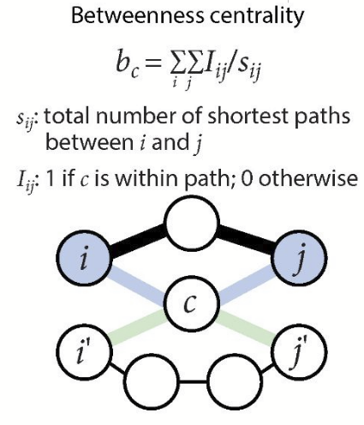
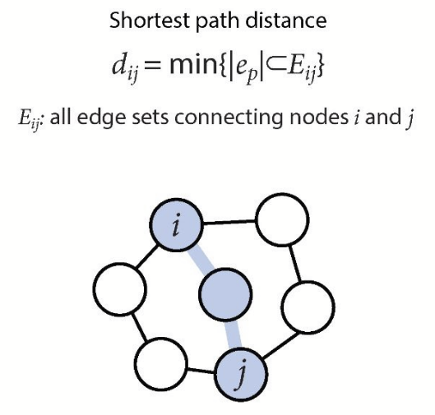

Slide 10
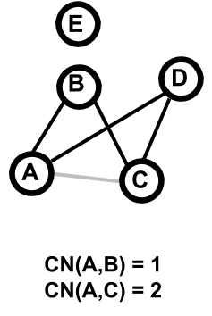
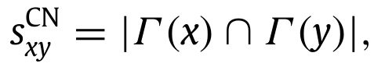
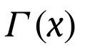
Common Neighbors
← neighbours of x
Nodes with more common neighbors,
are more likely similar to each other

Slide 11
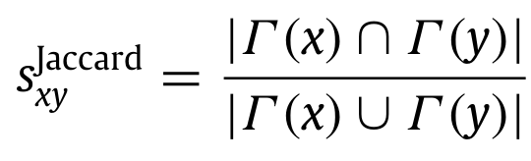
Jaccard Similarity
same as common neighbors, adjusted for degree

Slide 12
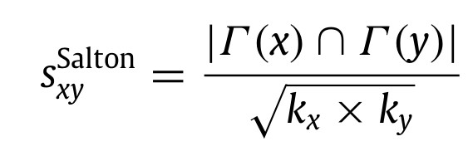
Cosine Similarity
K_{i} degree of x,y

Slide 13
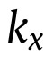
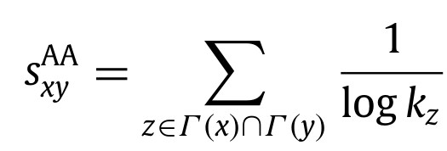
Adamic/Adar Similarity
← degree of x
weighting rarer neighbors more heavily

Slide 14
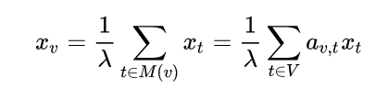
Eigenvector centrality
Eigenvector centrality is used to measure the level of influence of a node within a network
Relationships originating from high-scoring nodes contribute more to the score of a node than connections from low-scoring nodes.
The PageRank algorithm is a variant of Eigenvector Centrality with an additional jump probability.

Slide 15
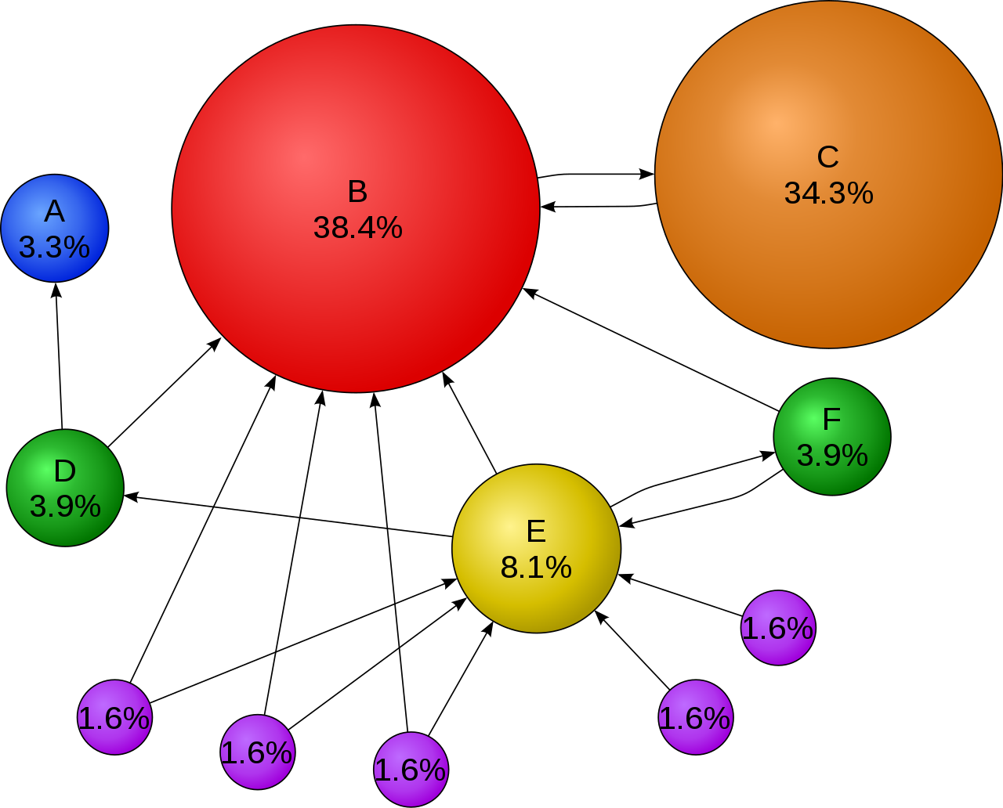
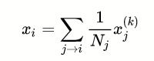
PageRank
PageRank algorithm was developed by Larry Page and Sergey Brin, the founders of Google, while they were students at Stanford University.
PageRank measures the importance of website pages based on the links between them. It is based on a normalized eigenvector centrality, combined with a random jump.
Each node, x_{i}, has a PageRank as defined by the sum of pages j that link to i times one over the outlinks or "out-degree" of j times the "importance" or PageRank of j .

Slide 16
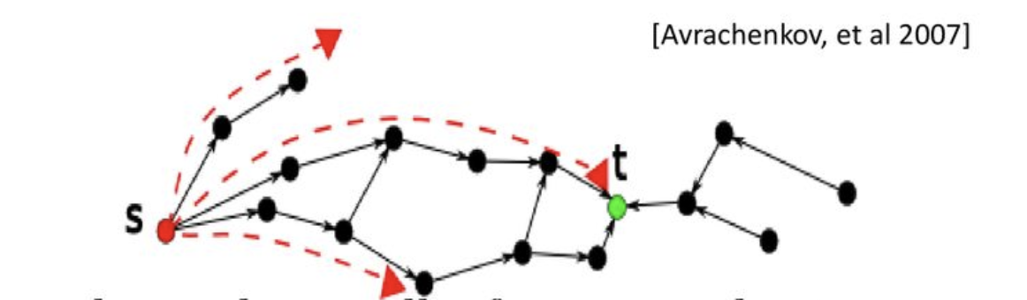
Rooted (Personalized) PageRank
calculates popularity score for each node
with respect to root node s (starting node of “browsing”). (given source s, target t and stopping probability.)

Slide 17
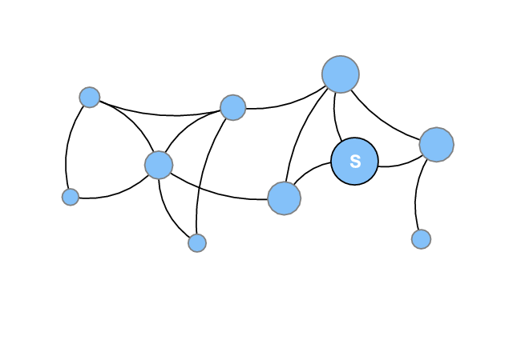
Random Walk with Restart
Imagine a network, and starting at a specific node, you follow the edges randomly.
But with some probability, you “jump” back to the node (restart!).
0.8
If you keep doing the random walk, you will obtain a ranking of other nodes with respect to the start node.
0.3
0.7
0.6
0.8
0.2
0.8
0.4
likelihood of forming a link from the start node.
0.1
Start
Notes:
If you recorded the number of times you land on each node,
Problem: Ignores edge types

Slide 18
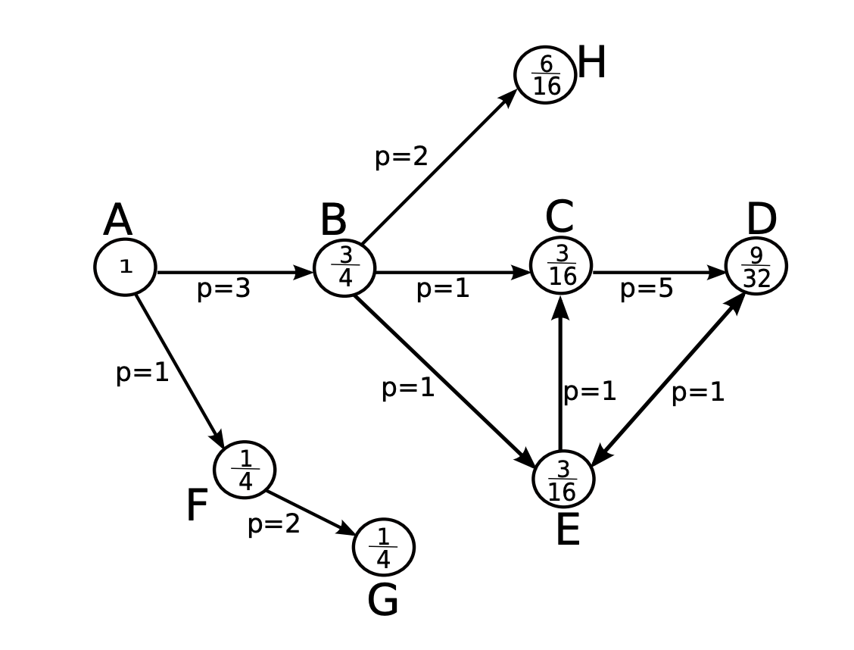
PropFlow
Similar to rooted PageRank
Makes restricted random walks of at most h steps
on edge-weighted graph
starting at x and ending at y
Probability of following a link is proportional to its edge-weight

Slide 19
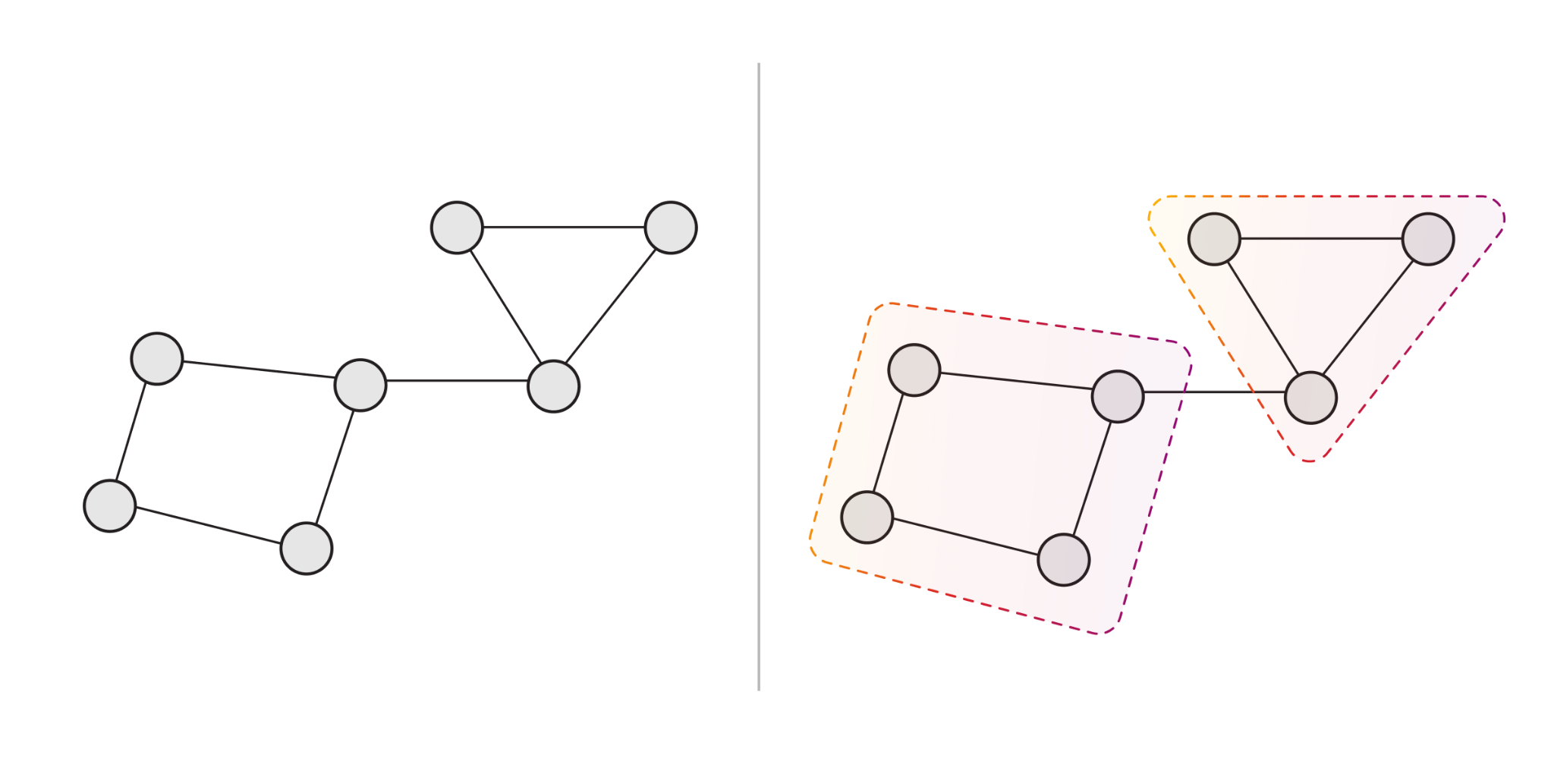
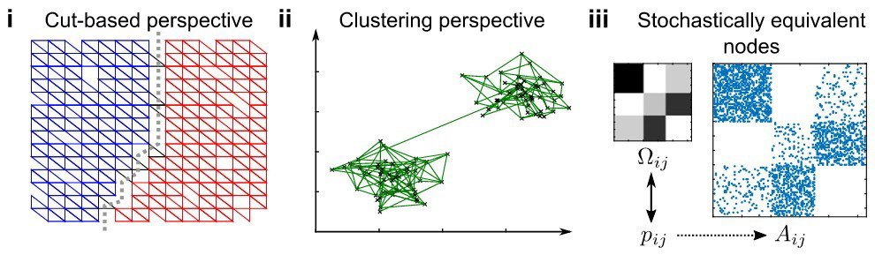
Topological Clustering

Slide 20
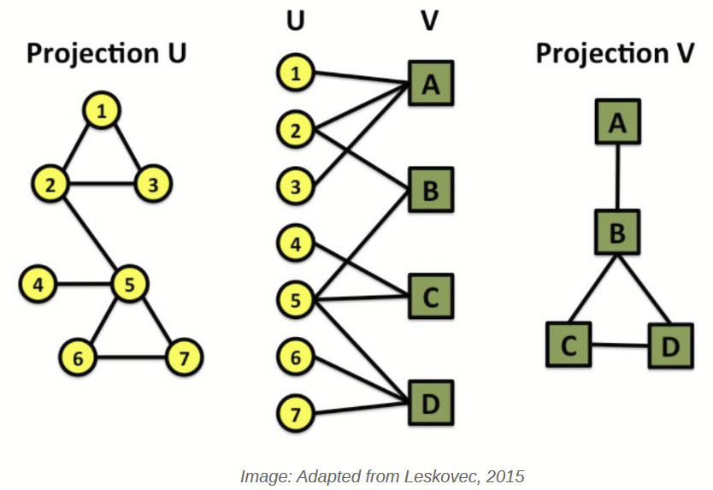
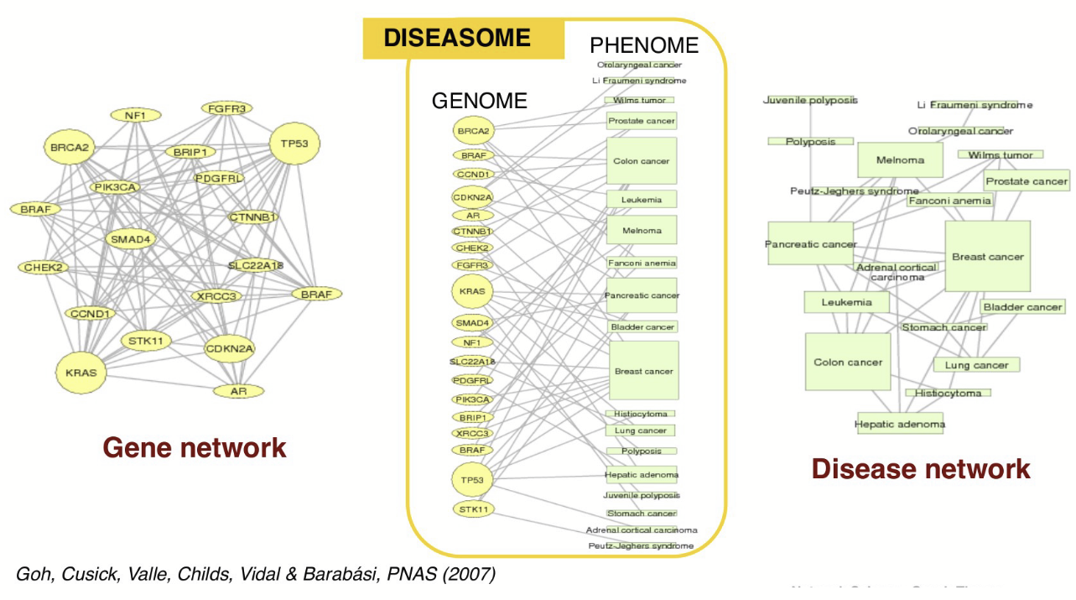
Bipartite Graph
A bipartite graph is a graph whose nodes can be divided into two disjoint sets U and V such that every edge connects a node in U to one in V.
Two “types” of nodes. No edges between nodes of the same type

Slide 21
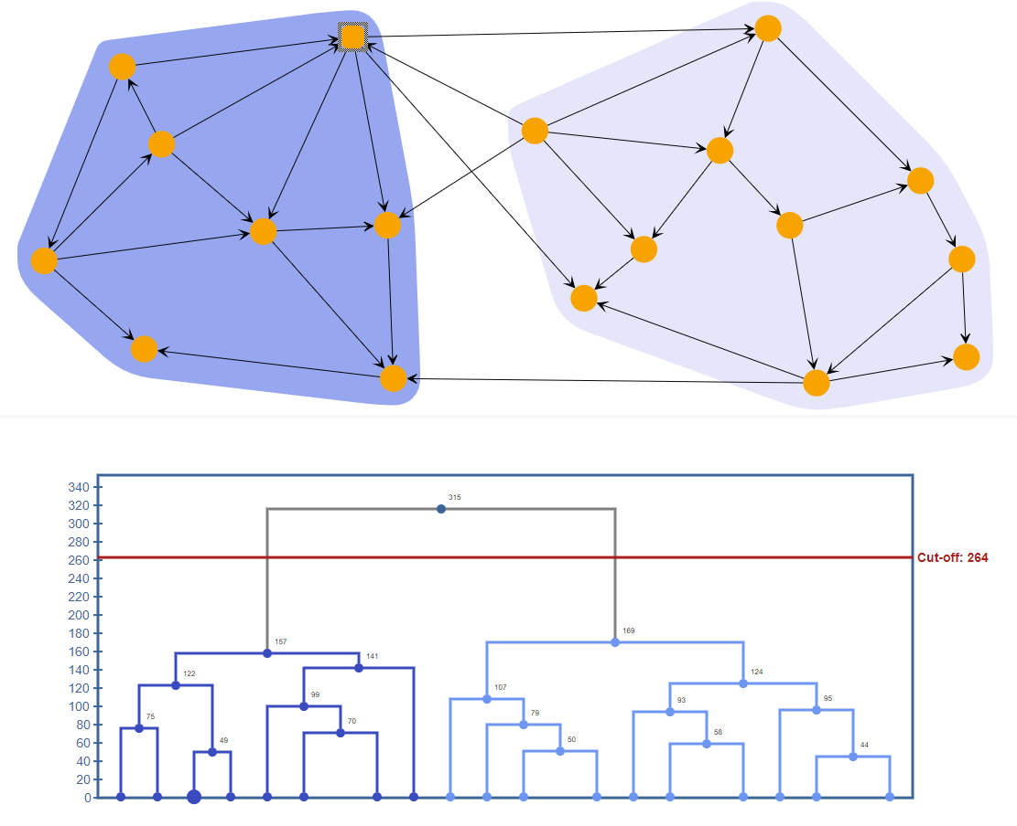
Hierarchical Clustering
Hierarchical clustering partitions the graph into a hierarchy of clusters.
* Agglomerative strategy applies a bottom-up approach: Each node put into a separate cluster and subsequent steps the algorithm merges pairs of clusters while moving up the hierarchy. The algorithm continues until all nodes belong to the same cluster.
* Divisive strategy applies a top down approach where all nodes are initially grouped into one cluster. At each step, the algorithm splits the largest cluster while moving down to the hierarchy.
The dissimilarity between clusters is determined based on the given linkage criterion and an appropriate distance metric as euclidean distance, euclidean-squared distance, manhattan distance, or Chebyshev distance.
The result is a dendrogram which can be cut based on a given cut-off value.

Slide 22
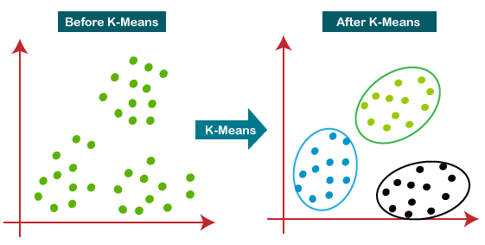
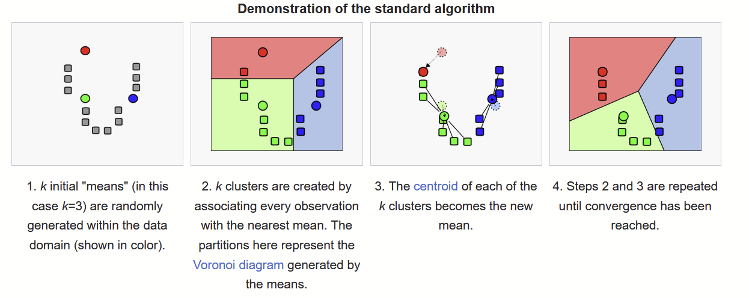
K-Means Clustering
K-means clustering aims to partition n observations into k clusters in which each observation belongs to the cluster with the nearest mean (cluster centers or cluster centroid).

Slide 23
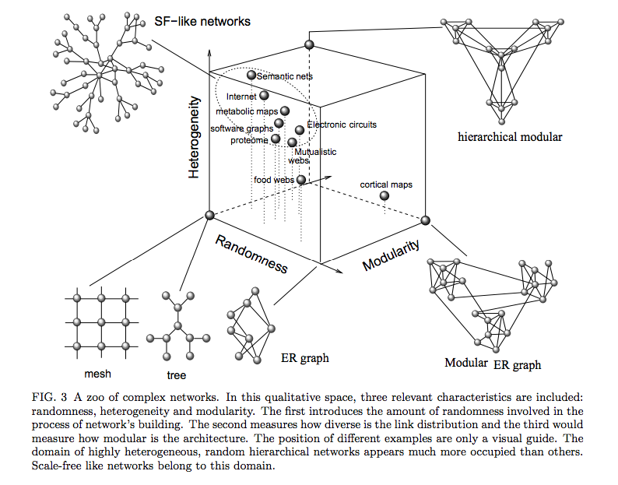
Network Characterization
Information Theory of Complex Networks: on evolution and architectural constraints by Sole and Valverde (2004)

Slide 24
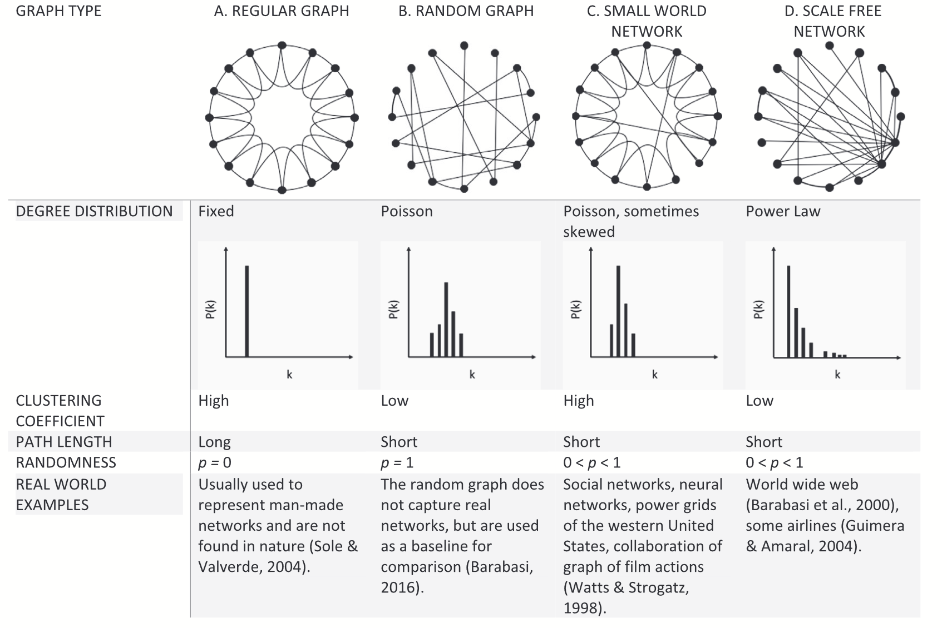
Network Structures

Slide 25
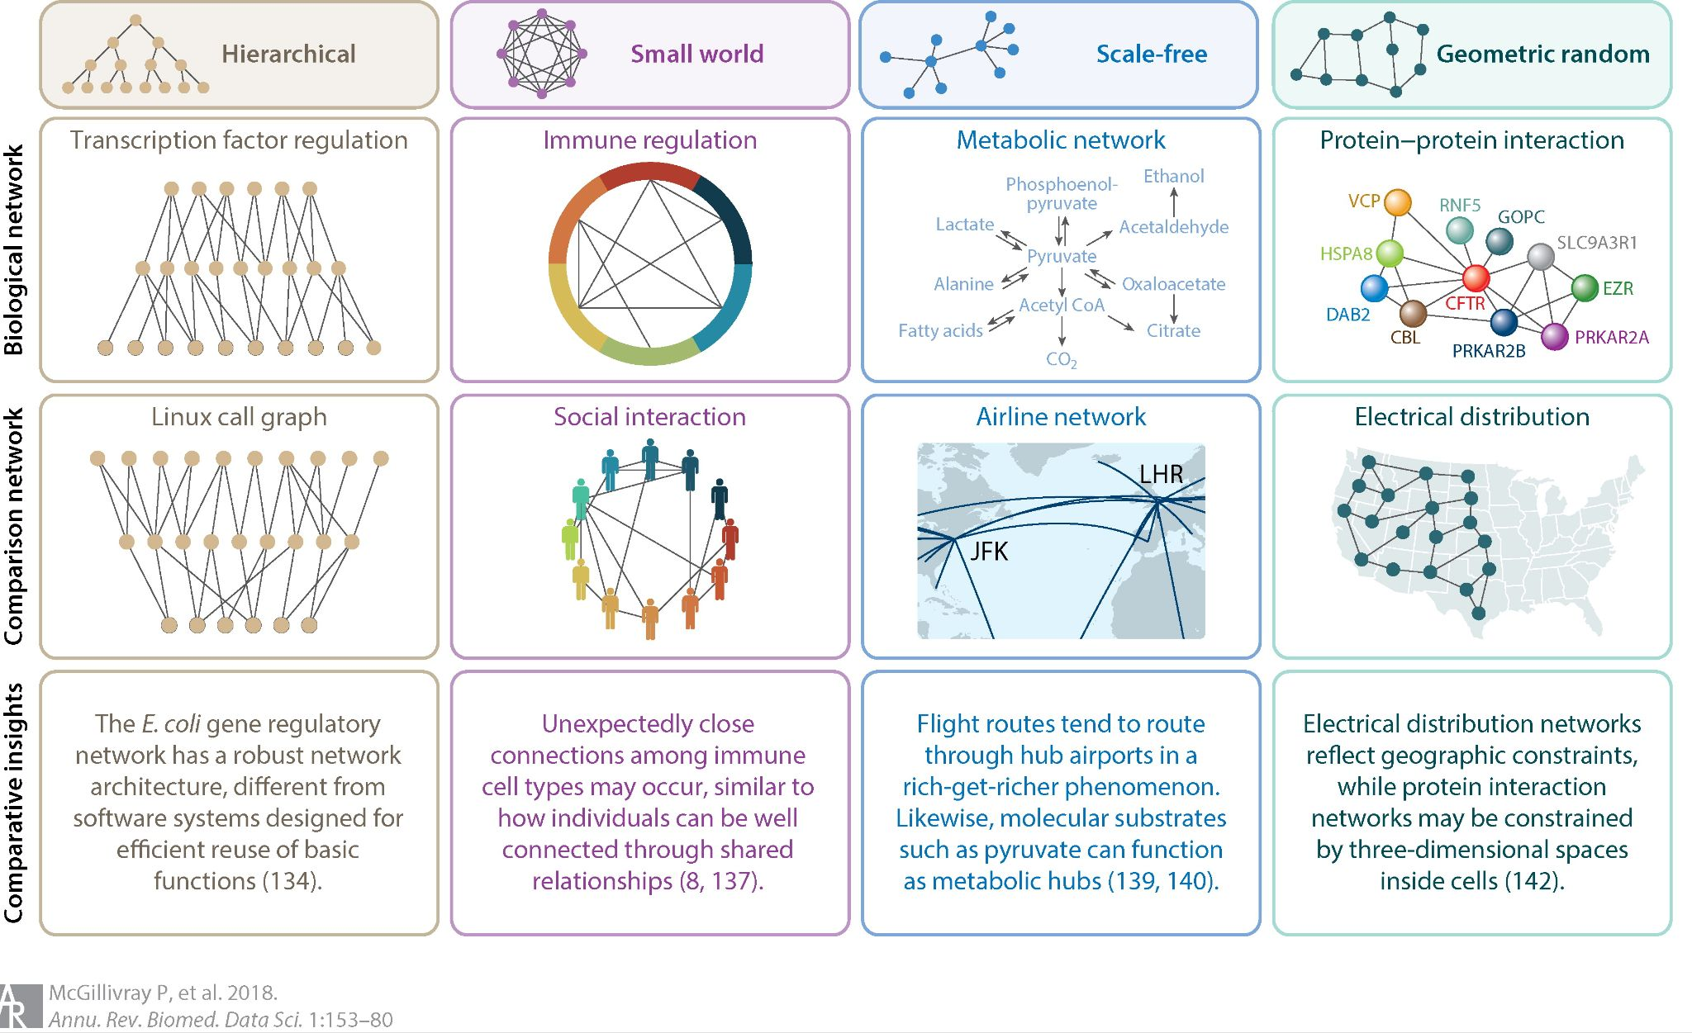

Slide 26
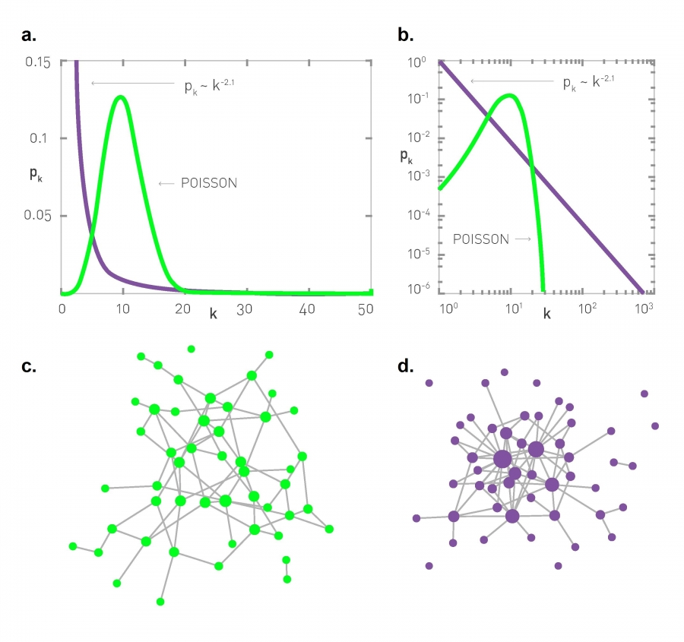
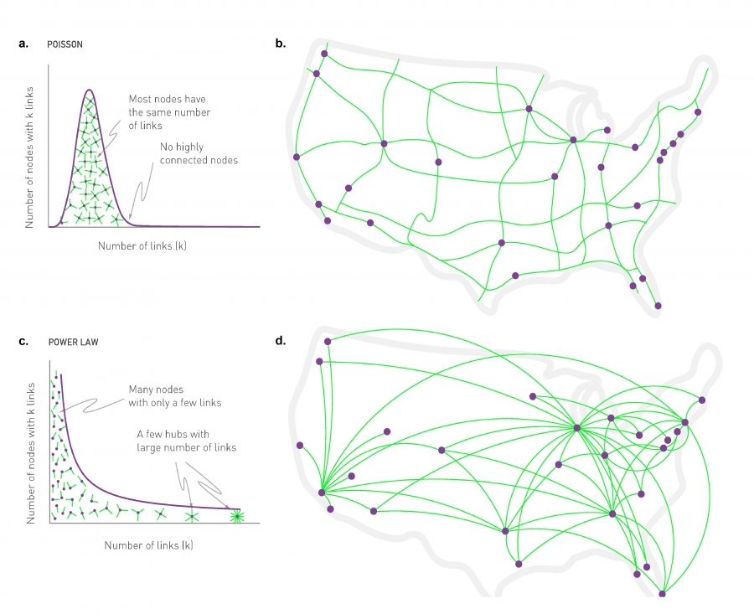

Slide 27
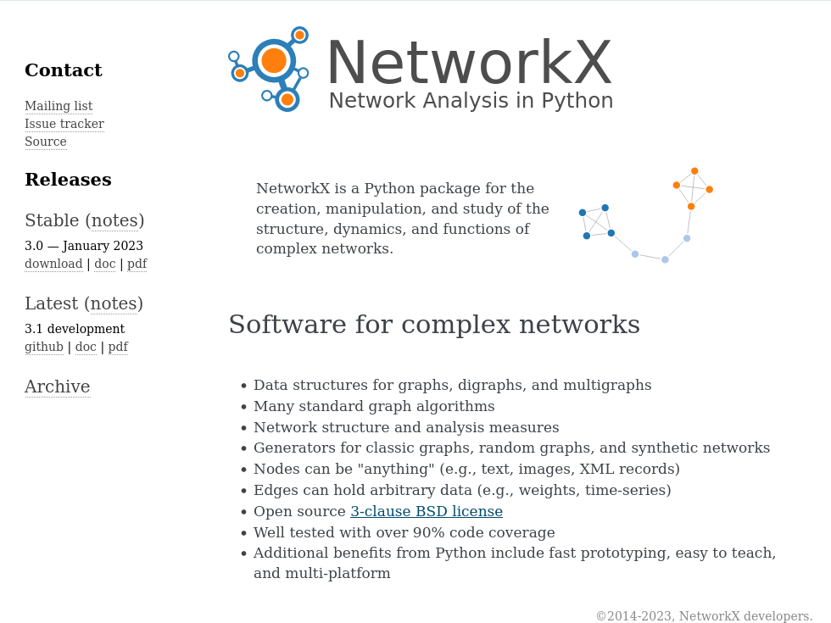
Tools
https://networkx.org/

